Slide 1

By Yves Janssens (215C)
This presentation template was created by Slidesgo, including icons by Flaticon, and infographics & images by Freepik.

Slide 2
Problem Statement
Objective
Many Kickstarter projects fail to reach their funding goals due to a lack of strategic planning.
Project creators often struggle with determining the optimal campaign duration, pledge goals, launch timing, and project type to maximize their chances of success.
Without clear data-driven guidance, many campaigns fail to attract sufficient backers, leading to lost opportunities for innovation and business growth.
The objective of this analysis is to provide Kickstarter project creators with actionable insights based on historical data to increase their chances of running a successful crowdfunding campaign. Specifically, this analysis aims to:
 Identify the optimal duration for a campaign.
 Determine the ideal pledge goal range that balances
attainability and profitability.
 Highlight which project categories have the highest success.
 Identify the best time (month, day) to launch a campaign for
maximum visibility and engagement.
By leveraging data-driven insights, this research will enable Kickstarter to offer an effective consulting service that empowers project founders to make informed decisions, improving their chances of success.

Slide 3
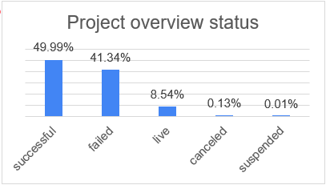
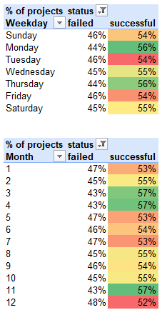
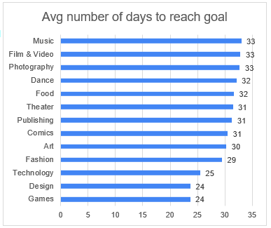
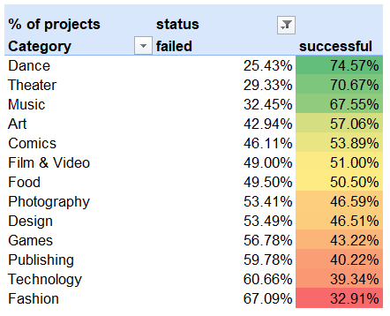
DATA ANALYSIS


Slide 4
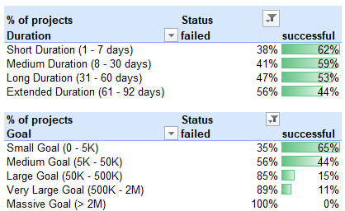
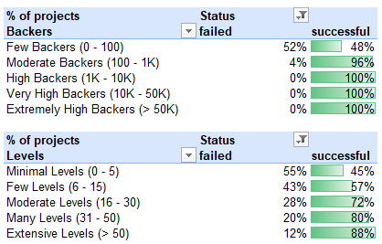
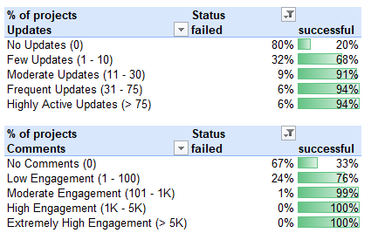
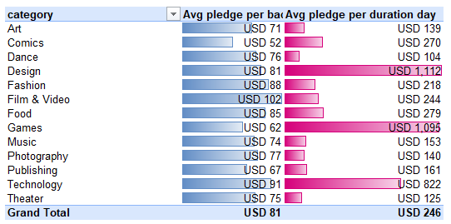
DATA ANALYSIS

Slide 5
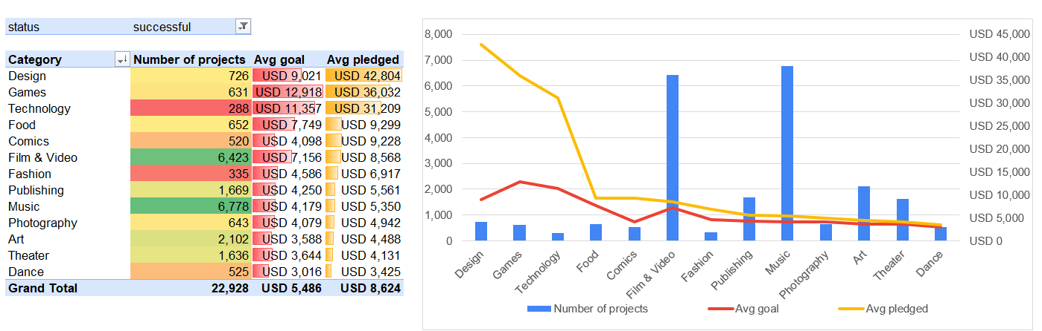
DATA ANALYSIS

Slide 6
RECOMMENDATIONS
By following these insights, project creators can increase their chances of success by optimizing campaign strategy, engagement, and funding goals while leveraging the most promising categories and timing trends.
Set Realistic and Attainable Funding Goals
Smaller goals ($5K or less) have much higher success rates.
Technology, Product Design, and Video Games require higher funding but attract significant backer investment.
Optimize Campaign Duration
Run campaigns for 30 days or less to maintain urgency and engagement.
Build a Strong Community Before Launch
Projects with 1,000+ backers always succeed.
Launch Timing Considerations
January to April have higher success rates. Avoid launching in December due to historically lower success rates.

Slide 7
RECOMMENDATIONS
Offer Multiple Reward Levels
Include at least 16+ reward tiers to appeal to different backer budgets.
Have small, mid-range, and premium pledge options..
Engage and Communicate Frequently
Post 30+ updates throughout the campaign to keep backers engaged.
Encourage comments and discussion to build excitement and trust.
Leverage High-Demand Categories
Games, Design, and Technology attract strong financial backing.
Smaller creative projects (Crafts, Graphic Design, General Games) tend to exceed their goals and are safer for creators.
Adapt to Backer Behavior
Design, Games, and Technology campaigns attract high daily funding momentum, making shorter, high-intensity campaigns effective.
Film & Video, Technology, and Fashion attract higher pledges per backer, so focus on compelling storytelling and premium reward tiers

